Slide 1

Basic Details of the Team and Problem Statement
Ministry/Organization Name/Student Innovation: MSME
PS Code: RK1121
Problem Statement Title: Developing virtual reality based solution.
Team Name: VROOM.
Team Leader Name: Surya Narayanan CS.
Institute Code (AISHE): AK 1109
Institute Name: Sona college of technology.
Theme Name: Smart Education

Slide 2
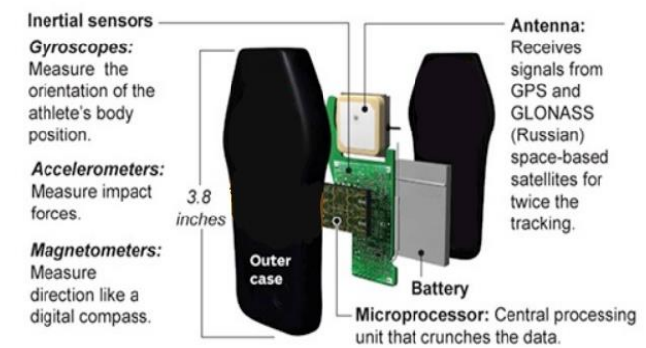
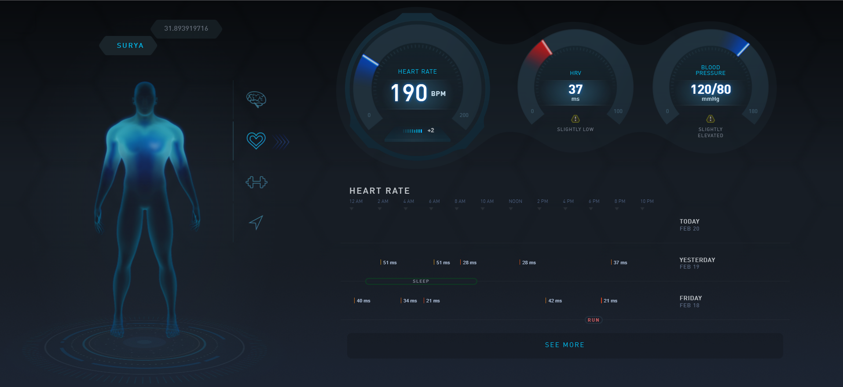
Approach:
1. Smart wearable to track and record the player's movement in real-time using GPS. During post-game analysis, playback the player movement to understand/study the team’s performance.
2. Detecting the fouls, ball outside field, etc., using the parameters like sound, proximity to help the umpires make the decision.
3. Find the player’s health (tiredness) and inform the coach / manager who can be put to rest using parameters like step count, movement, heart rate etc.
4. Hockey dashboard - Cloud/Web-based software for the organizer to start the new game, add players, goals, game timer and update players’ specific data like goals, foul, game timer etc. Dashboard view for the spectators for the selected game with an automatic scoreboard update.
Fig 1.1 : System Architecture
Highlights:
This is initially done to hockey but based on the parameters of other sports, can be applicable to other field sports like football, cricket, etc,.
HARDWARE REQUIREMENTS:
Max 30100 sensor
GPS module
Knock sensor
Lactic echo sensor
Inertial sensor
SOFTWARE REQUIREMENTS:
HTML,CSS, Mapbox
Mongo DB
AWS
Fig 1.2 : Health status page

Slide 3
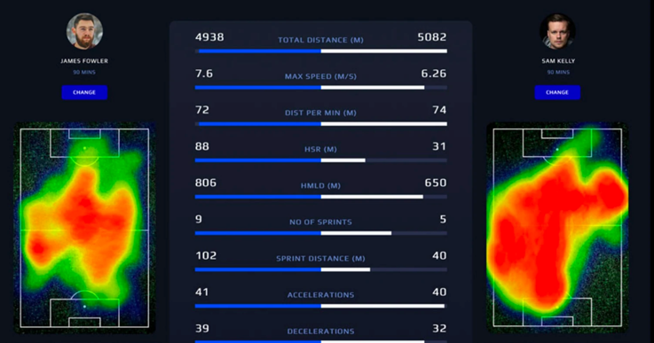
Use Cases:
Wearing the device
GPS tracks the movements for every 0.5s
Health status & foul status of the player will be monitored
Fig 1.3 : Analysis of two player using GPS
Will update in backend dashboard
Key Summary:
A wearable device is placed on the human’s upper arm which features sensors :
* MAX3010 – pulse oximeter sensor for monitoring the blood oxygen levels and pulse level.
* Lactic sensor for measuring the tiredness.
* Inertial sensors which measures the acceleration and angular velocity of an object along three mutually perpendicular axes based on the physical laws.
PLAYER
COACH, ANALYSIST
Abnormality will be detected
DEPENDENCIES:
Internet Connectivity.

Slide 4
Team Member Details
Team Leader Name: Surya Narayanan CS
Branch : B.E Stream : ECE Year : II
Team Member 1 Name: Rithvikailas G
Branch : B.E Stream :ECE Year :II
Team Member 2 Name: Amiritavarshini S
Branch : B.E Stream: ECE Year : II
Team Member 3 Name: Harshini D A
Branch : B.E Stream : ECE Year : II
Team Member 4 Name: Abinanthan B
Branch : B.E Stream : ECE Year : I
Team Member 5 Name: Guruprasath M
Branch : B.E Stream: ECE Year : I
Team Mentor 1 Name: Mr. Anand
Category : Academic Expertise : AI/ML

